Slide 1

PROJECT ON
PREDICTION OF FINANCIAL DELINQUENCY
PROBLEM STATEMENT
Improve on the state of the art in credit scoring by predicting the probability that somebody will experience financial distress in the next two years.
~ Group 2:
Hemanthkumar E (19BM6JP27)
Rajat Gupta (19BM6JP17)
Satya (19BM6JP61)
Sugandha Ranjan (19BM6JP21)
Suman Basak (19BM6JP62)
Suman Pal (19BM6JP22)

Slide 2

PLAN OF EXECUTION
EDA (Exploratory Data Analysis) – The dependencies and relationships between various attributes of data have been studied.
Data cleansing and pre-processing – Based on EDA, data containing missing values, or outliers have been imputed and corrected.
Predictive Data Analytics – With the help of features created, several models were utilized in order to predict the unknown values. Output from different models are compared.
Feature Engineering – Based on EDA, certain features were generated which would increase the efficiency of the model. The features formed are certain combination of attributes.
The performance of models with and without generated features were also compared.
Challenges and Future Prospects have also been stated.

Slide 3
A LOOK AT THE DATASET…
Variable Name | Description | Type
SeriousDlqin2yrs | Binary variable whether a person would experience financial distress in two years or not | Y/N
RevolvingUtilizationOfUnsecuredLines | Ratio of money owed to credit limit | Percentage
Age | Age of borrower in years | Integer
NumberOfTime30-59DaysPastDueNotWorse | Number of times borrower has been 30-59 days past due | Integer
DebtRatio | Monthly debt payments, alimony, living costs divided by monthly gross income | Percentage
MonthlyIncome | Monthly income | Real
NumberOfOpenCreditLinesAndLoans | Number of open loans (installment like car loan or mortgage) | Integer
NumberOfTimes90DaysLate | Number of times borrower has been 90 days or more past due | Integer
NumberRealEstateLoansOrLines | Number of mortgage and real estate loans including home equity lines of credit | Integer
NumberOfTime60- 89DaysPastDueNotWorse | Number of times borrower has been 60-89 days past due | Integer
NumberOfDependents | Number of dependents in family excluding themselves (spouse, children etc.) | Integer
Training data containing 150k records

Slide 4
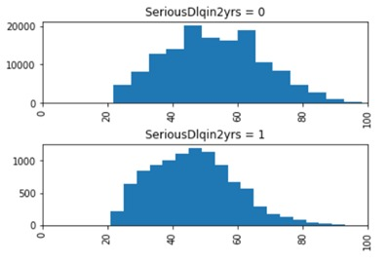
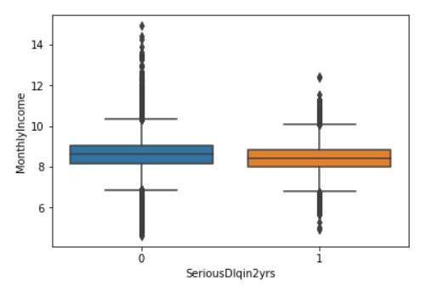
EXPLORATORY DATA ANALYSIS
DISTRIBUTION OF AGE W.R.T. SeriousDlqin2yrs - If you're over 55 and need a mortgage, the important thing to know is that lenders can't deny you a loan based on your age. But age can factor into your mortgage equation. In order to solve this, we need to confirm that in our data set age has a negative influence on probability of defaulting. Then we can assume that the models we build reflect that trend and won't deny someone a loan simply because they are old. Looking at the distribution of people that defaulted vs those who did not shows us that, generally, younger people were more responsible for defaulting. So, we're good to go, legally.
DISTRIBUTION OF log(MONTHLY INCOME) W.R.T. SeriousDlqin2yrs – The box plot above shows the variation of log(monthly_income). Log is taken only for visualization purpose to check the overall distribution of the variable as it exhibits high dispersion. 0s and 1s have been removed from this analysis which accounted for 2300 entries in total.

Slide 5
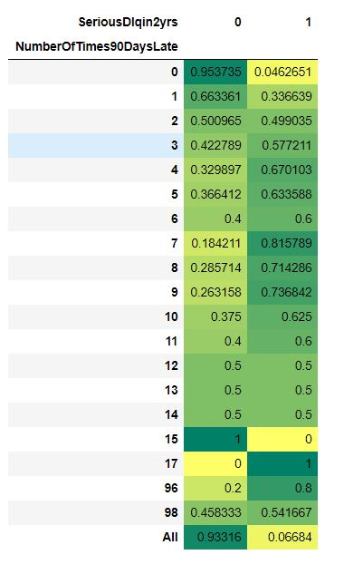
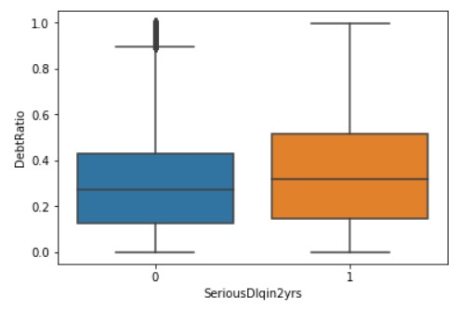
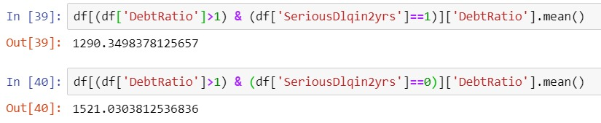
EXPLORATORY DATA ANALYSIS
DISTRIBUTION OF DEBT RATIO W.R.T. SeriousDlqin2yrs – box plot below is for records debt ratio < 1 which accounts for around 1.18 lakhs in total. The distribution for debtratio >1 is analysed by mean.
DISTRIBUTION OF NumberOfTimes90DaysLate W.R.T. SeriousDlqin2yrs
The above contingency table shows that as NumberOfTimes90DaysLate increases (up to 9), the proportion of defaulters increases. After 10, the data corresponding to 1 is very less which won’t give appropriate distribution. Similar pattern follows in other NumberOfTimes()DaysLate

Slide 6
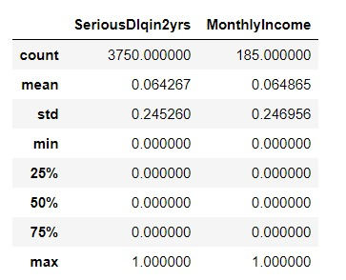

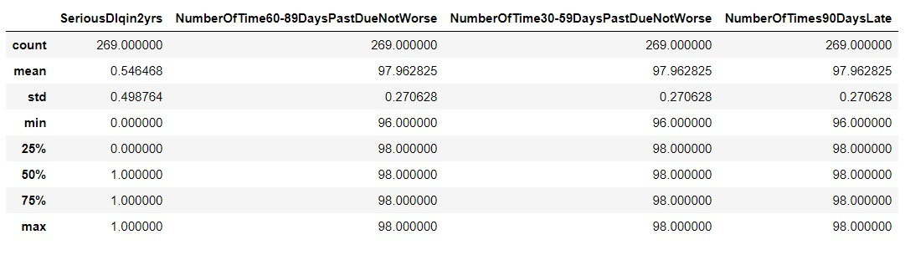
DATA CLEANSING AND PRE-PROCESSING
CHECK FOR OUTLIERS:
In Debt Ratio
Apparently 2.5% of the dataset owes more than 3,500 times what they own. We need to investigate further to see if these are outliers or not.
We see two particularly concerning things here. The first is that of 4,000 records with DebtRatio > 3,500, only 185 of them have a value for monthly income. Further, the people who do have monthly income seem to either have a monthly income of either 1 or 0.
In NumberOfTimes()DaysPastDueNotWorse
Somehow, all these (269) people were 30-59 days late 96/98 times, 60-89 days late 96/98 times, and 90+ days late 96/98 times. However, the data might not be garbage, because (as expected) these people are defaulting at a massive rate (55%) compared to the population (6%).

Slide 7
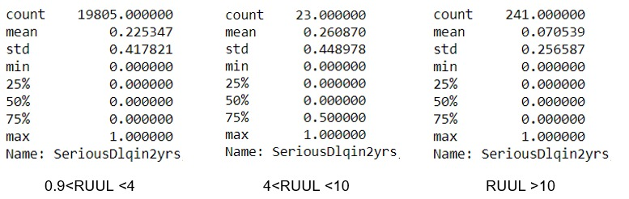
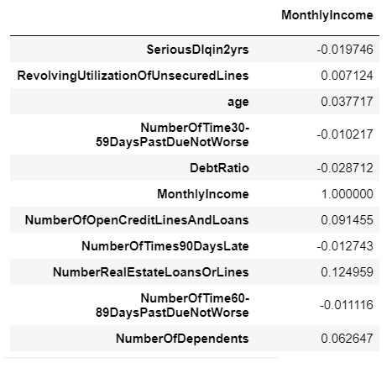
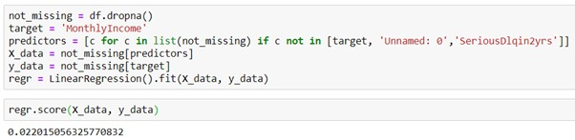
DATA CLEANSING AND PRE-PROCESSING
In RevolvingUtilizationOfUnsecuredLines
The adjacent table shows that as RUUL increases, the mean SeriousDlqIn2yrs increases i.e. from 0.<RUUL<4 to 4<RUUL<10, which is expected
However, for the second range shift to RUUL>10, the mean is very less, 0.07, which cannot happen and makes the data suspicious.
Hence RUUL>10 data are outliers.
IMPUTATION:
Regressing Monthly_Income on other variables gives very low value of R2 and correlation, which shows a poor fit and hence, regression cannot be used for imputation.
Median is chosen for all imputations as data is skewed and mean wouldn’t be proper for filling missing values.

Slide 8
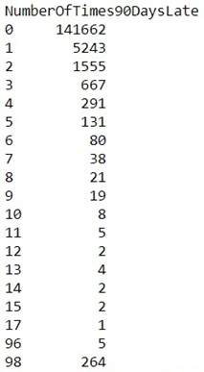
FEATURE ENGINEERING WRT DATA MODELS
Median – Fill: All the null values in the data frame are replaced with corresponding median values.
Removed Debt Outliers: Outliers with debt ratio >3500 (2.5% of data) are removed and median-fill.
Remove 98s – Number of times 90 days late (96-98) have been replaced with value of 18 to maintain consistency
Removed utilization outliers: Values of RUUL>10 have been removed.
Drop Missing: Missing data has been removed prior to analysis.

Slide 9
PREDICTIVE DATA ANALYSIS – SUPERVISED LEARNING
Different Data Models are compared for two classifiers – Random Forest and Support Vector Machine, with respect to their AUC Scores.
For better estimation of the metrics, we have used a K-Fold Cross Validation with k=4.
For classification problems, AUC scores are used for comparing different models.
Data Model | Random Forest | SVM
Removed Utilization Outliers | 0.8624 | 0.6019
Removed 98s | 0.8592 | 0.6179
Removed Debt Outliers, Median-Fill | 0.8586 | 0.6098
Median-Fill | 0.8572 | 0.6208
Drop Missing | 0.8496 | 0.5954

Slide 10
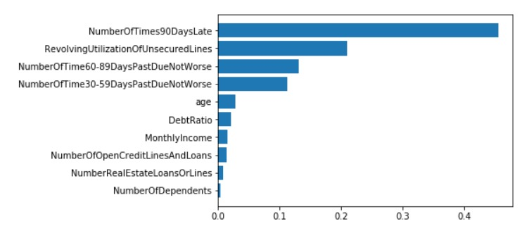
PREDICTIVE DATA ANALYSIS
After comparing all the different models, we used the best one i.e. Removed Utilization Outliers Data trained by Random Forest to generate various metrics such as feature importance, Confusion matrix and ROC Curve

Slide 11
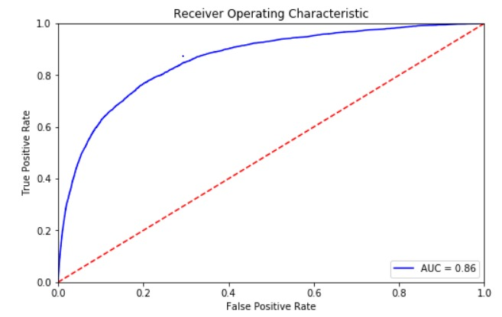
PREDICTIVE DATA ANALYSIS
Since we can see clearly that Random Forest worked better than SVM, we will go ahead with Random Forest as classifier and tuned its parameters.
We had a test AUC value of 0.86, hence we could afford to increase our True Positive Rate without significantly effecting our True Negative rate by adjusting the threshold value.
For default prediction, generally recall score is of more importance.
According to the profit function, which would be a function of TPR and FPR, we can select an optimised threshold value from ROC Curve.
 | Predicted (No) | Predicted (Yes)
Actual (No) | 56820 | 4716
Actual (Yes) | 1950 | 2535
Precision | Recall | F1-Score
0.3496 | 0.5652 | 0.432

Slide 12
TUNING
Data Model | No. of estimators | Maximum Depth | AUC Score
Removed 98s | 18 | 8 | 0.8648
Removed 98s | 14 | 9 | 0.8642
Removed Debt Outliers, Median-Fill | 15 | 8 | 0.8640
Median-Fill | 17 | 8 | 0.8639
Removed Utilization Outliers | 18 | 8 | 0.8638
Removed 98s | 11 | 8 | 0.8637
Removed Utilization Outliers | 11 | 9 | 0.8636
Removed Debt Outliers, Median-Fill | 16 | 9 | 0.8635
Removed Debt Outliers, Median-Fill | 10 | 6 | 0.8634
Removed Debt Outliers, Median-Fill | 17 | 7 | 0.8633

Slide 13
PREDICTIVE DATA ANALYSIS – KNN CLASSIFIER
Data Model | No. of neighbors (k) | AUC Score
Removed 98s | 6 | 0.5267
Removed Utilization Outliers | 7 | 0.5222
Removed Utilization Outliers | 8 | 0.5214
Removed Utilization Outliers | 9 | 0.5197
Removed 98s | 9 | 0.5196
Removed Utilization Outliers | 6 | 0.5189
Removed Debt Outliers, Median-Fill | 7 | 0.5168
Removed 98s | 5 | 0.5160
Removed Debt Outliers, Median-Fill | 5 | 0.5156
Median-Fill | 9 | 0.5149

Slide 14
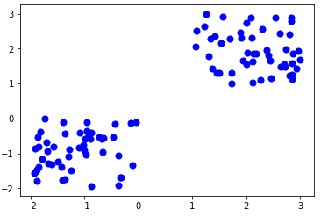
CHALLENGES
IMBALANCED DATA: Number of SeriousDlqIn2yrs (output variable = 1) accounts for only 7% of the data.
K MEANS CLUSTERING:
We have also tried to cluster the data with K-Means Clustering and analyzed whether different clusters created differ with one another with respect to default proportion.
We have varied the number of clusters from 2 to 7 but the ratio of default in each cluster was found to be around 6.7%, which is also the population default proportion.

Slide 15


FUTURE PROSPECTS
TUNING OF MORE THAN TWO PARAMETERS:
As of now, we have used number of estimators and depth as parameters to fine-tune AUC scores for different models.
But we can also use the criteria to measure the quality of split (Gini or Entropy), or max_features to tune it further.
MAXIMIZING RECALL IN VIEW OF BUSINESS ASPECTS:
Finding optimum threshold to classify delinquency according to their business model.

